Slide 1
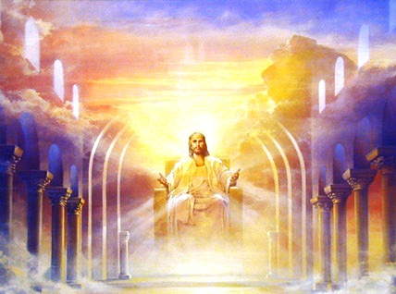
The Kingdom Or The Church?

Slide 2
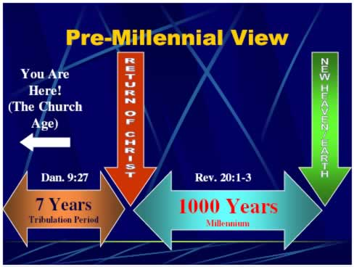

Slide 3
“We are ‘premillennialists’ in viewpoint. The real issue between amillennial and the premillennial viewpoints is whether prophecy should be interpreted literally or allegorically … all prophecy about past events has been fulfilled literally, particularly the predictions regarding the first coming of Christ. The words of prophecy were demonstrated as being literal, that is, having the normal meaning understood by the people of the time in which it was written. The words were not intended to be explained away by men who cannot believe what is clearly predicted.”
H. Lindsey, The Late Great Planet Earth, p. 176.

Slide 4
The Bible Says that prophetic language, as a rule is NOT literal:
Numbers 12:6-8
Hosea 12:10
Revelation 1:1 ( shmeiÒw = “to communicate by a sign”)

Slide 5
Luke 3:3-6
(Isaiah 40:3-5)

Slide 6
Matthew 17:1-13
(Malachi 4:5, 6)

Slide 8
“Let men say what they please, the church with it’s affairs, it’s origins, fortunes, and consummation, is the most simple and elevated theme to which the mind of man, to which the towering hierarchies of heaven can aspire … Let haughty mortals, aspiring to be gods on earth, frown and fret. The eternal glory of the church stands engraven on her gates and towers as the final consummation of God’s eternal purpose in creation, providence, and redemption”
Alexander Campbell

