Slide 1
Watching for the
New
World
Order

Slide 2
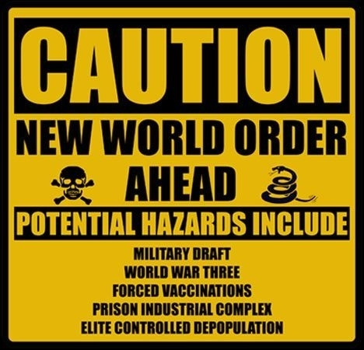

Slide 4
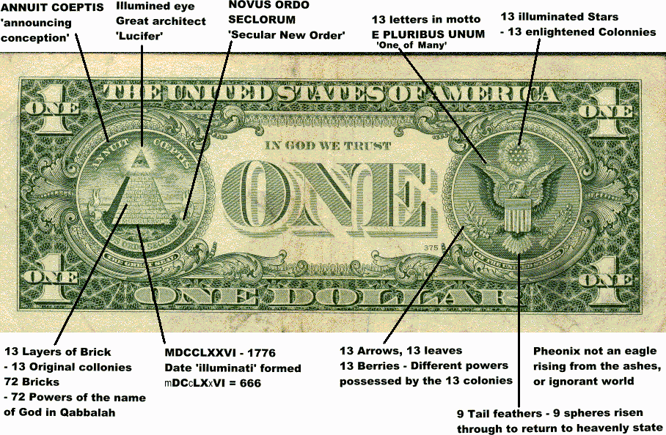
Conspiracy

Slide 5
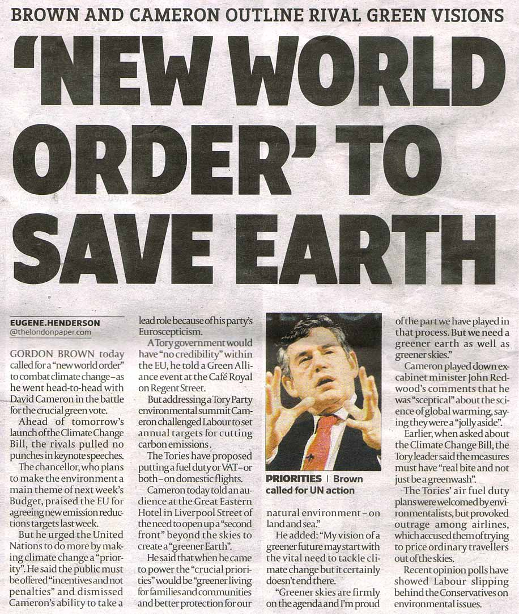

Slide 7
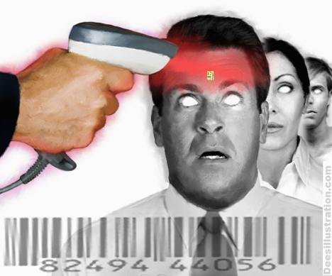
Found on Facebook
The New World order wants to micro chip all its members and all non chipped people will be....you tell me..

Slide 9
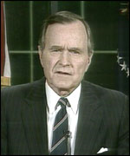
Now, we can see a new world coming into view. A world in which there is the very real prospect of a new world order. In the words of Winston Churchill, a "world order" in which "the principles of justice and fair play ... protect the weak against the strong ..." A world where the United Nations, freed from cold war stalemate, is poised to fulfil the historic vision of its founders. A world in which freedom and respect for human rights find a home among all nations

Slide 10
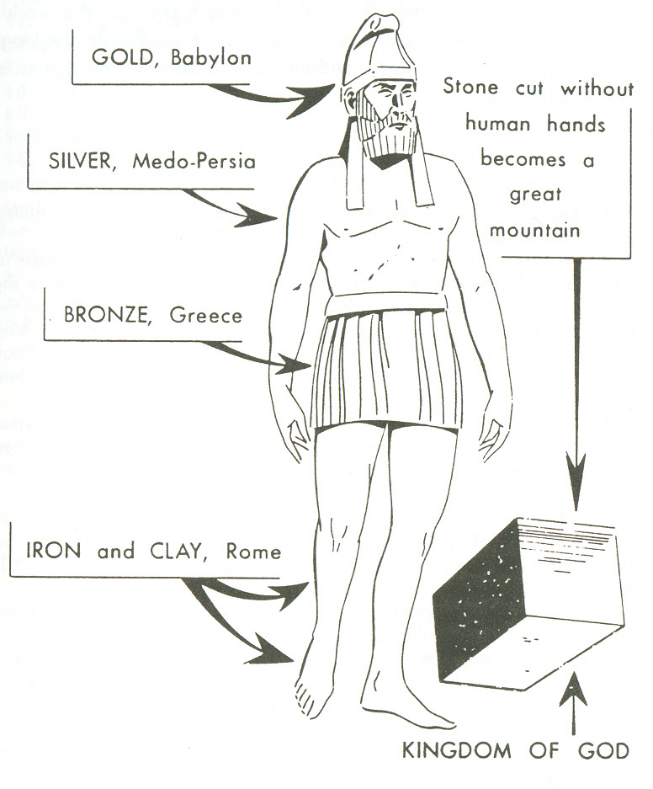

Slide 11
Heading the revived Roman Empire will be a man of such magnetism, such power, and such influence, that he will for a time be the greatest dictator the world has ever known. He will be the completely godless, diabolically evil “Future fuehrer.”
Hal Lindsey, The Late Great Planet Earth, p. 86

