Slide 1
The
New
Life

Slide 2
Acts 17:1-7

Slide 3
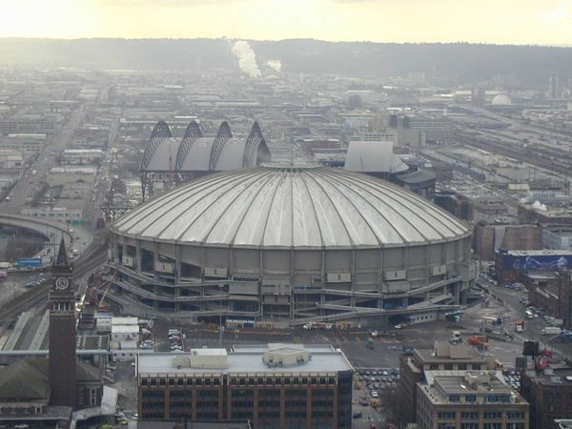

Slide 4
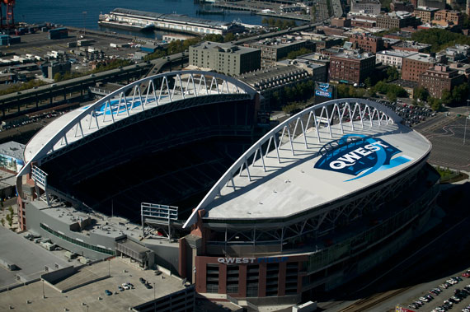

Slide 5
Ephesians 1:3-11

Slide 6
Ephesians 3:8-10

Slide 7
Other Scriptures
To look at:
Romans 8:28-30
Acts 2:23; 4:28
1 Peter 1:18-20

Slide 8
John 17:18

Slide 9
Isaiah 52:13-53:12

Slide 10
Plenty of Scriptures
Show this:
Hebrews 5:8,9; 10:7
John 4:34; 6:38; 10:17, 18
Philippians 2:7, 8
Romans 5:19
John 26:39

Slide 11
Our Eternal
Destiny
HAS BEEN
Determined
2 Timothy 1:9

Slide 12
2 Thess. 2:13
Romans 8:28-30
Ephesians 1:3-11

Slide 13
…so we too might walk in newness of life.

Slide 14
1. Made Alive
Ephesians 2:5

Slide 15
2. Regenerated
Titus 3:5

Slide 16
3. Renewed
Ephesians 4:23

Slide 17
4. New Creation
2 Cor. 5:17

Slide 18
5. Reborn
1 Peter 1:3, 22-23

