Slide 2
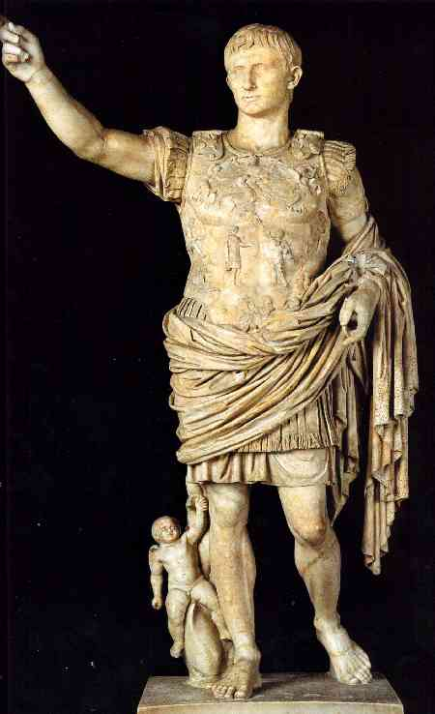
Augustus Caesar
31 BC – 14 AD

Slide 3
Micah 5:2

Slide 4
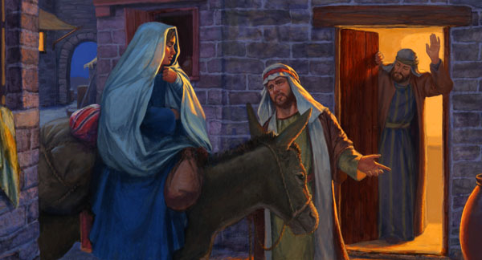

Slide 7
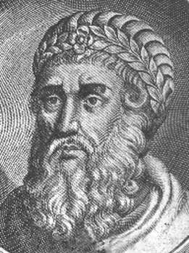
Herod
74 BC – 4 BC

Slide 8
Philippians 2:5-8

Slide 9
He came to His own, and those who were His own did not receive Him.
John 1:11

